Slide 1
Two crystal-skull assays
Face poking vs melittin (± morphine)
Same visual language: population traces, up vs down cells, FOV maps. Face poke is peri-event. Melittin is baseline vs injection (not time-locked, cells not matched). For SBI: which paradigm?

Slide 2
How to read the two assays
Face poke (13+18 Aug): 18 movies, 3 mice. t=0 is the poke. Excited/inhibited = 0.4–1.2 s vs −2–0 s, signed-rank p<0.05. No drug. Melittin: 12 BL/INJ recordings. Both arms cropped to the shorter duration. Up/down = injection cell vs baseline session mean (independent EXTRACT IDs). Melittin+morphine uses the same CS1014 mice on a different day.

Slide 3
1. Face poking
No drug | poke-locked | 18 movies

Slide 4

Face poke | population peri-poke (n = 18)
What: Gray = one movie. Red/black = mean ± SEM. Peri-window −2 to +3 s.
Result: A brief transient, a dip, then a rebound. 14/18 movies p<0.05. The all-cell mean is modest because excited and inhibited cells cancel.

Slide 5

Face poke | excited vs inhibited cells
What: Left: mean STA. Right: % of neurons per movie. Same 0.4–1.2 s vs −2–0 s rule.
Result: Movie-mean ~8.8% excited / 28.2% inhibited. Pooled: 3,719 / 43,156 excited (8.6%) and 11,908 inhibited (27.6%).

Slide 6
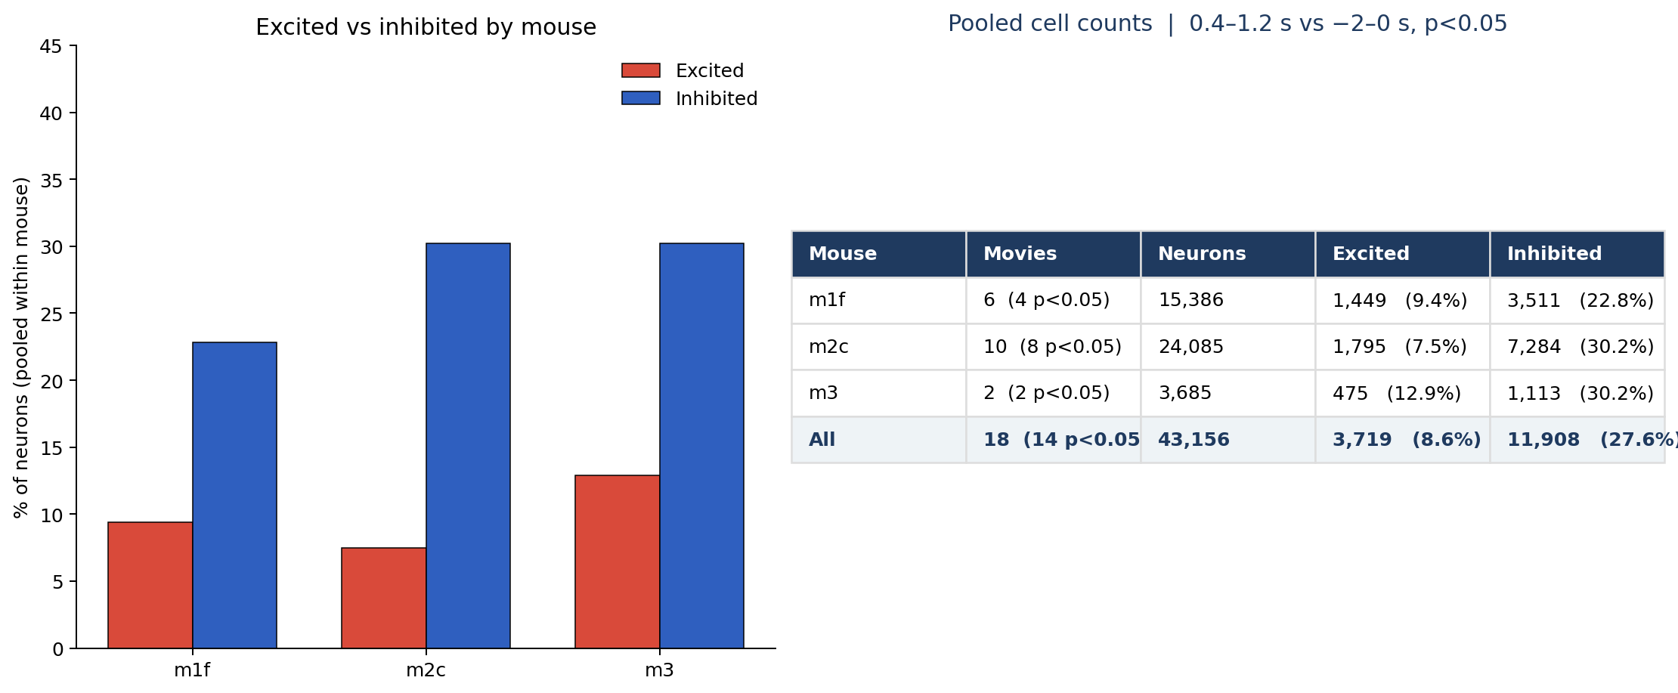
Face poke | how many cells per mouse
What: Pooled within mouse across movies (both days). Excited/inhibited as above.
Result: 14/18 movies p<0.05. Every mouse has more inhibited than excited cells.

Slide 7


Face poke | where they sit
What: Left: all FOVs (P left, A right). Right: AP bias of poke amplitude. Not CCF/Allen registered.
Result: Excited and inhibited cells are intermingled. 18/18 recordings: more excitation anterior, more inhibition posterior.

Slide 8
2. Melittin ± morphine
Not poke-locked | BL vs injection | matched to the shorter duration

Slide 9
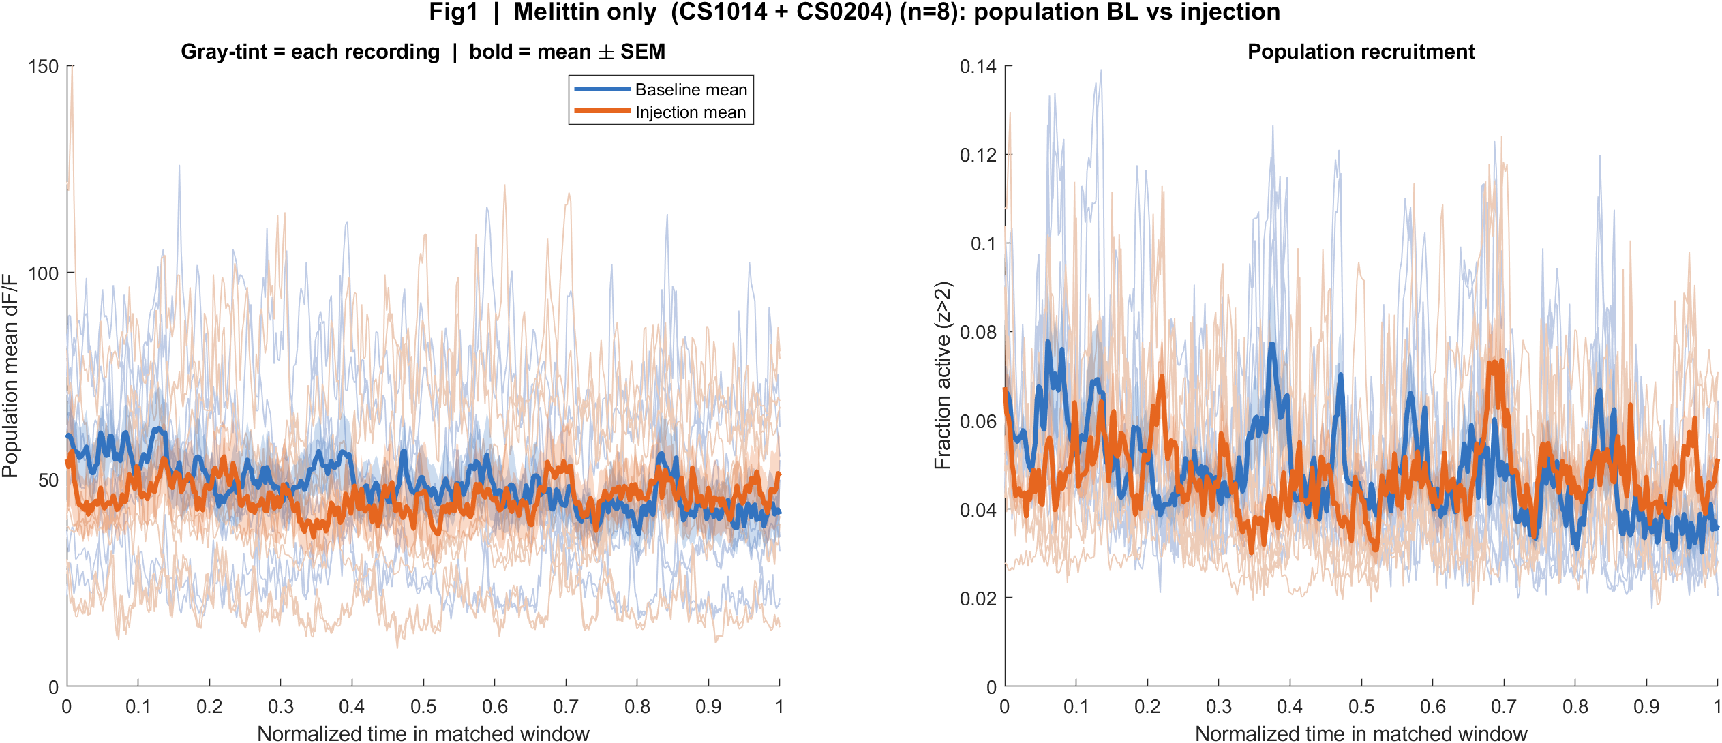
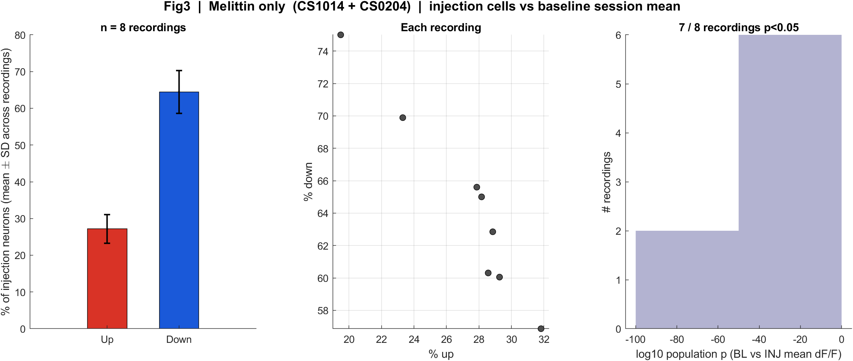
Melittin only | baseline vs injection (n = 8)
What: Same layout as face-poke Fig1/Fig3. Time is the recording, not a poke. Gray-tint = each recording.
Result: Population mean activity falls after injection in 7/8 recordings. Down cells outnumber up cells, as in face poke.

Slide 10
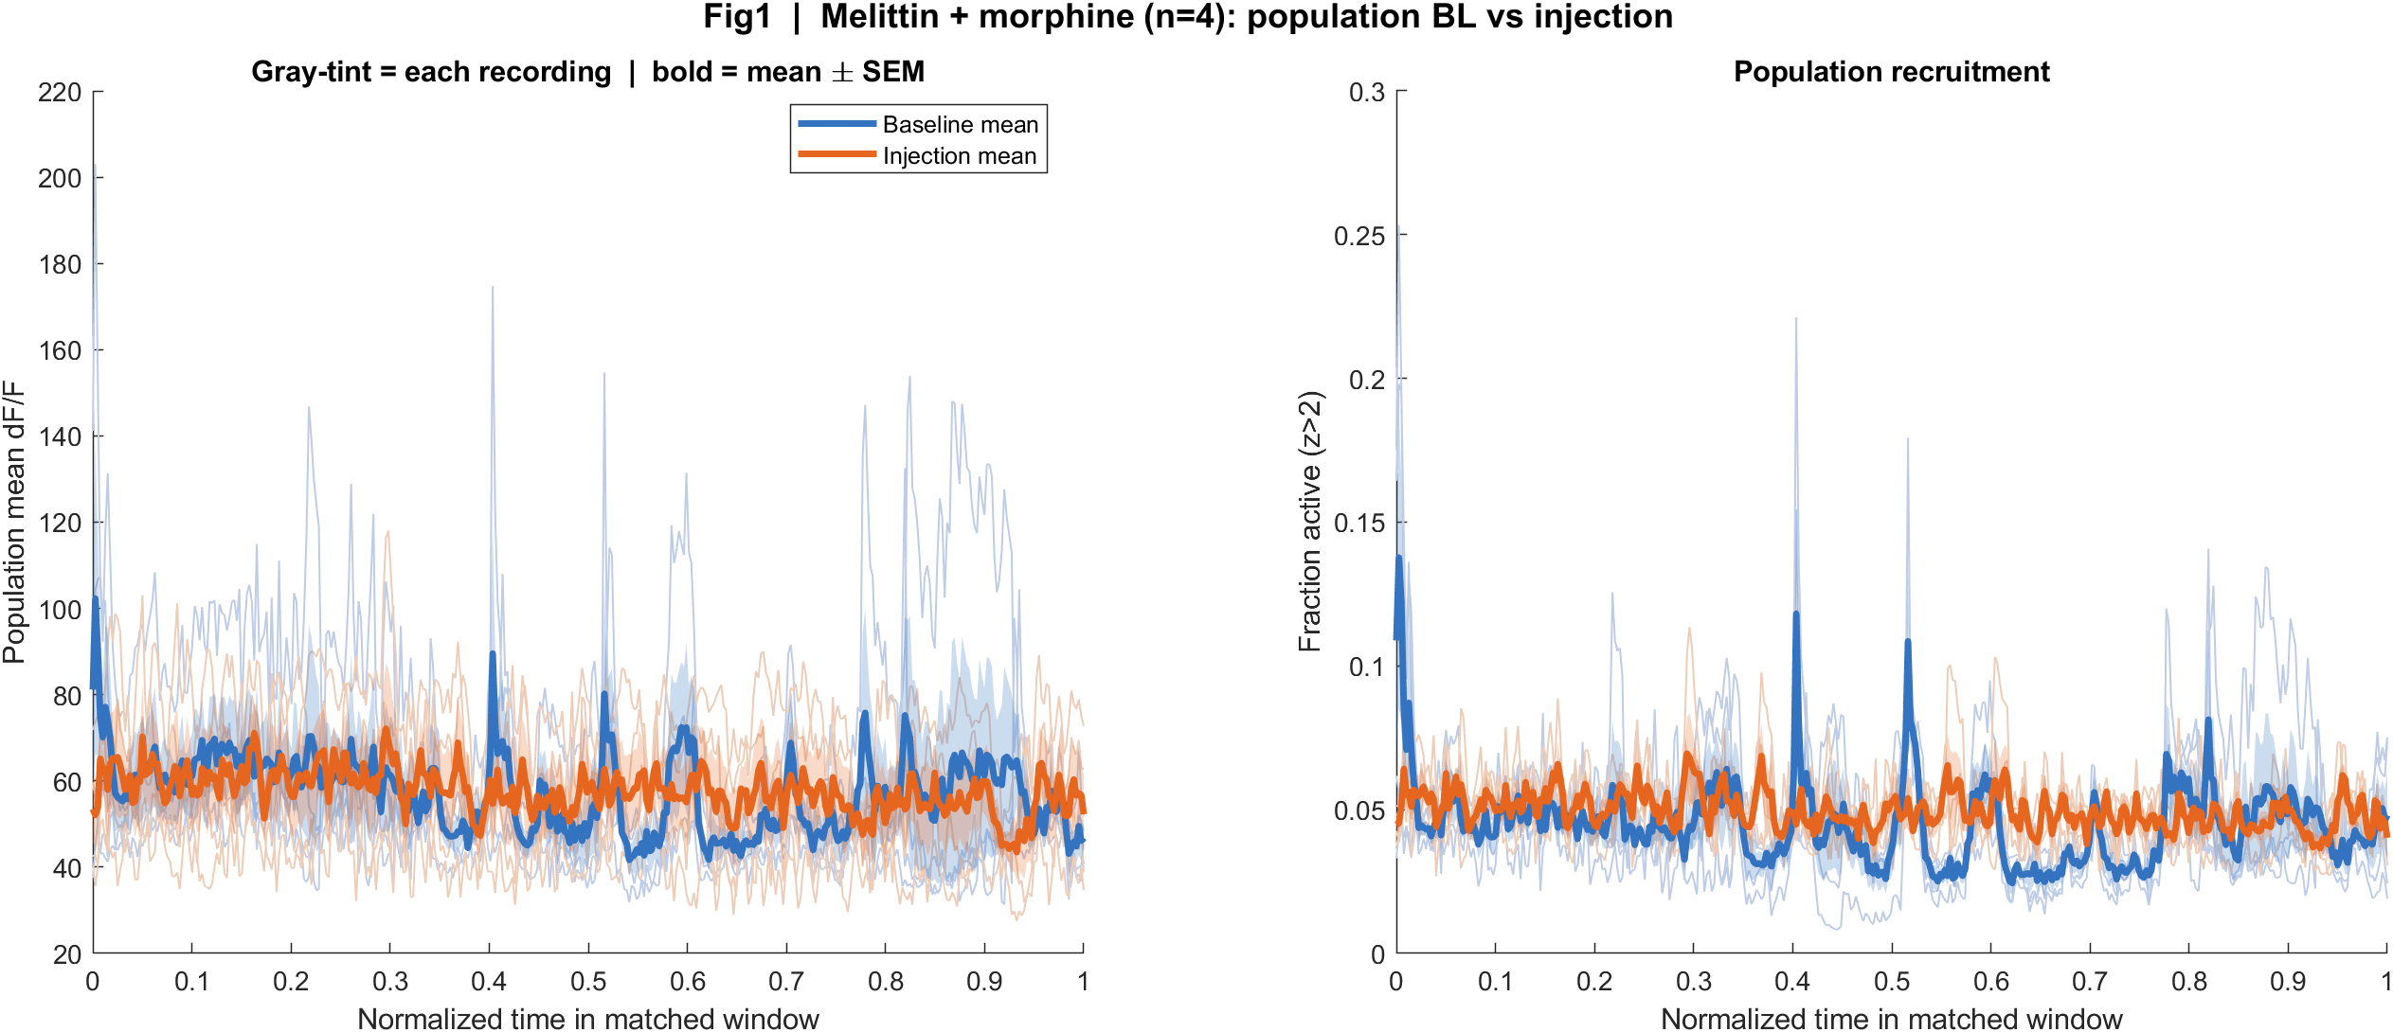
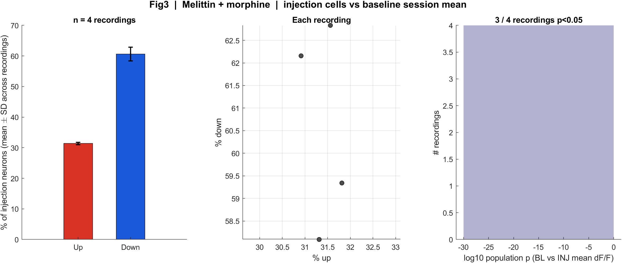
Melittin + morphine | baseline vs injection (n = 4)
What: Same CS1014 mice as the melittin-only pair, different day. Same crop-to-shorter-duration rule.
Result: Direction splits: 1/4 recordings Δ < 0. This is exploratory (small n).

Slide 11
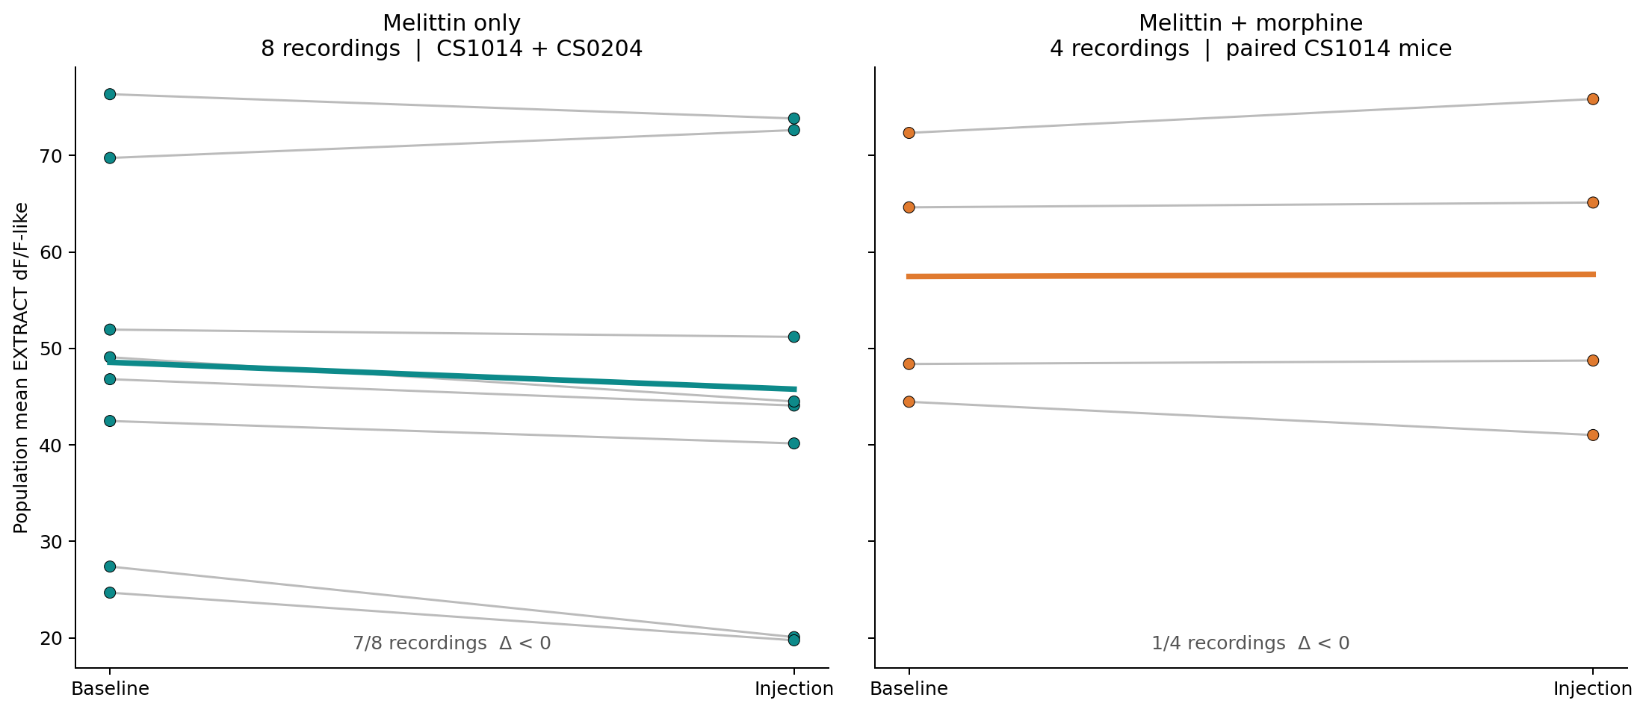
Three cases | baseline → injection
What: Each line is one recording. Left: melittin only. Right: melittin + morphine. Y = population mean EXTRACT activity (8th-pct dF/F-like).
Result: Melittin only: 7/8 go down. Morphine: 1/4. The thick line is the cohort mean.

Slide 12
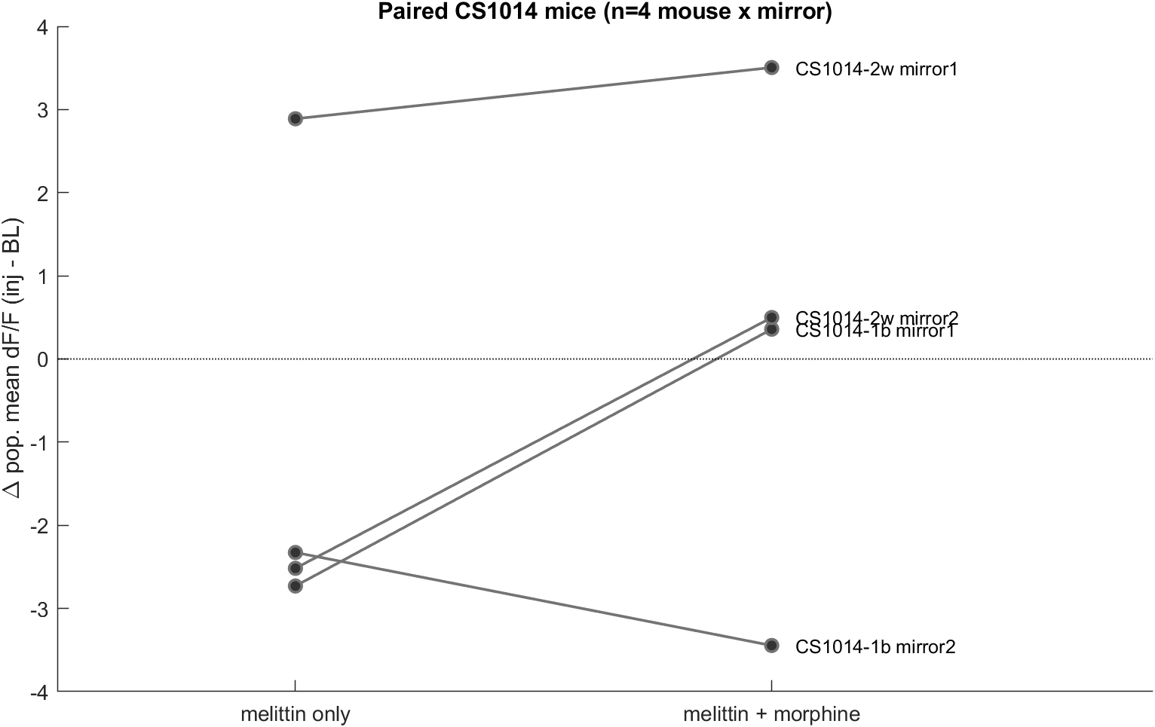
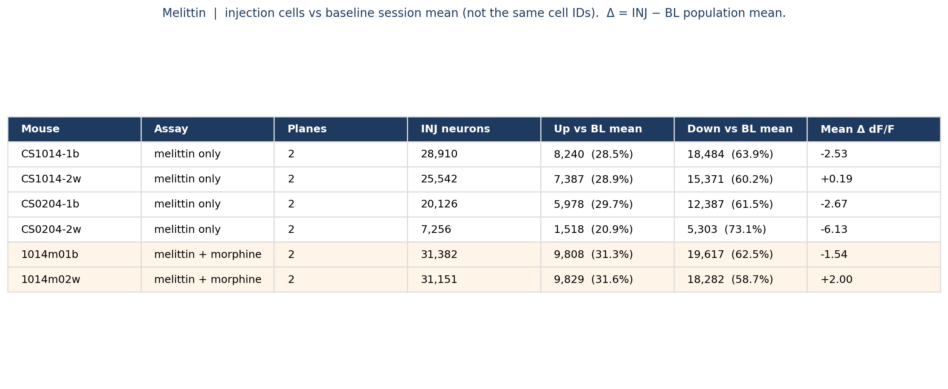
Melittin | per mouse, and paired CS1014
What: Left: injection-cell up/down vs BL session mean (not the same cells). Right: paired Δ (INJ − BL) for CS1014-1b/2w vs 1014m01b/02w.
Result: Melittin-only Δ is negative in every plane. In 3/4 paired CS1014 mouse×mirror lines, morphine is less suppressed or reversed.

Slide 13
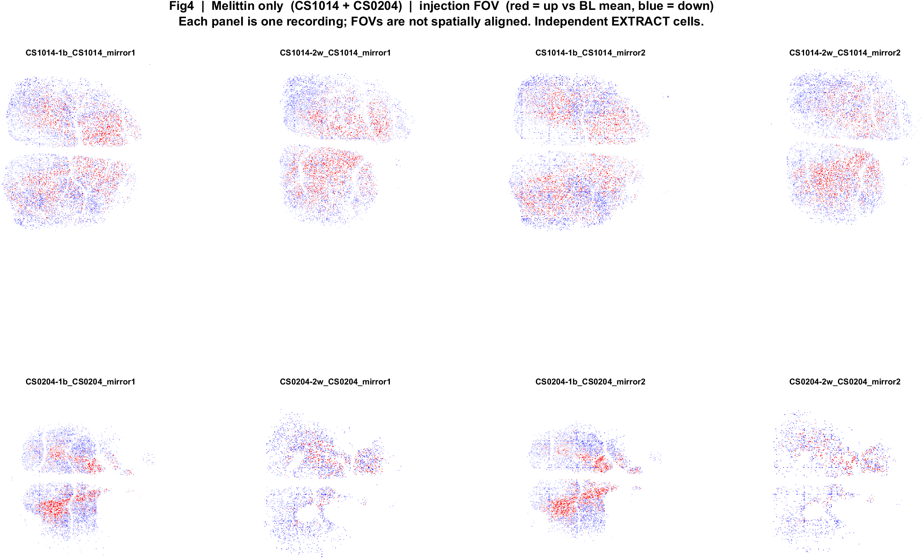
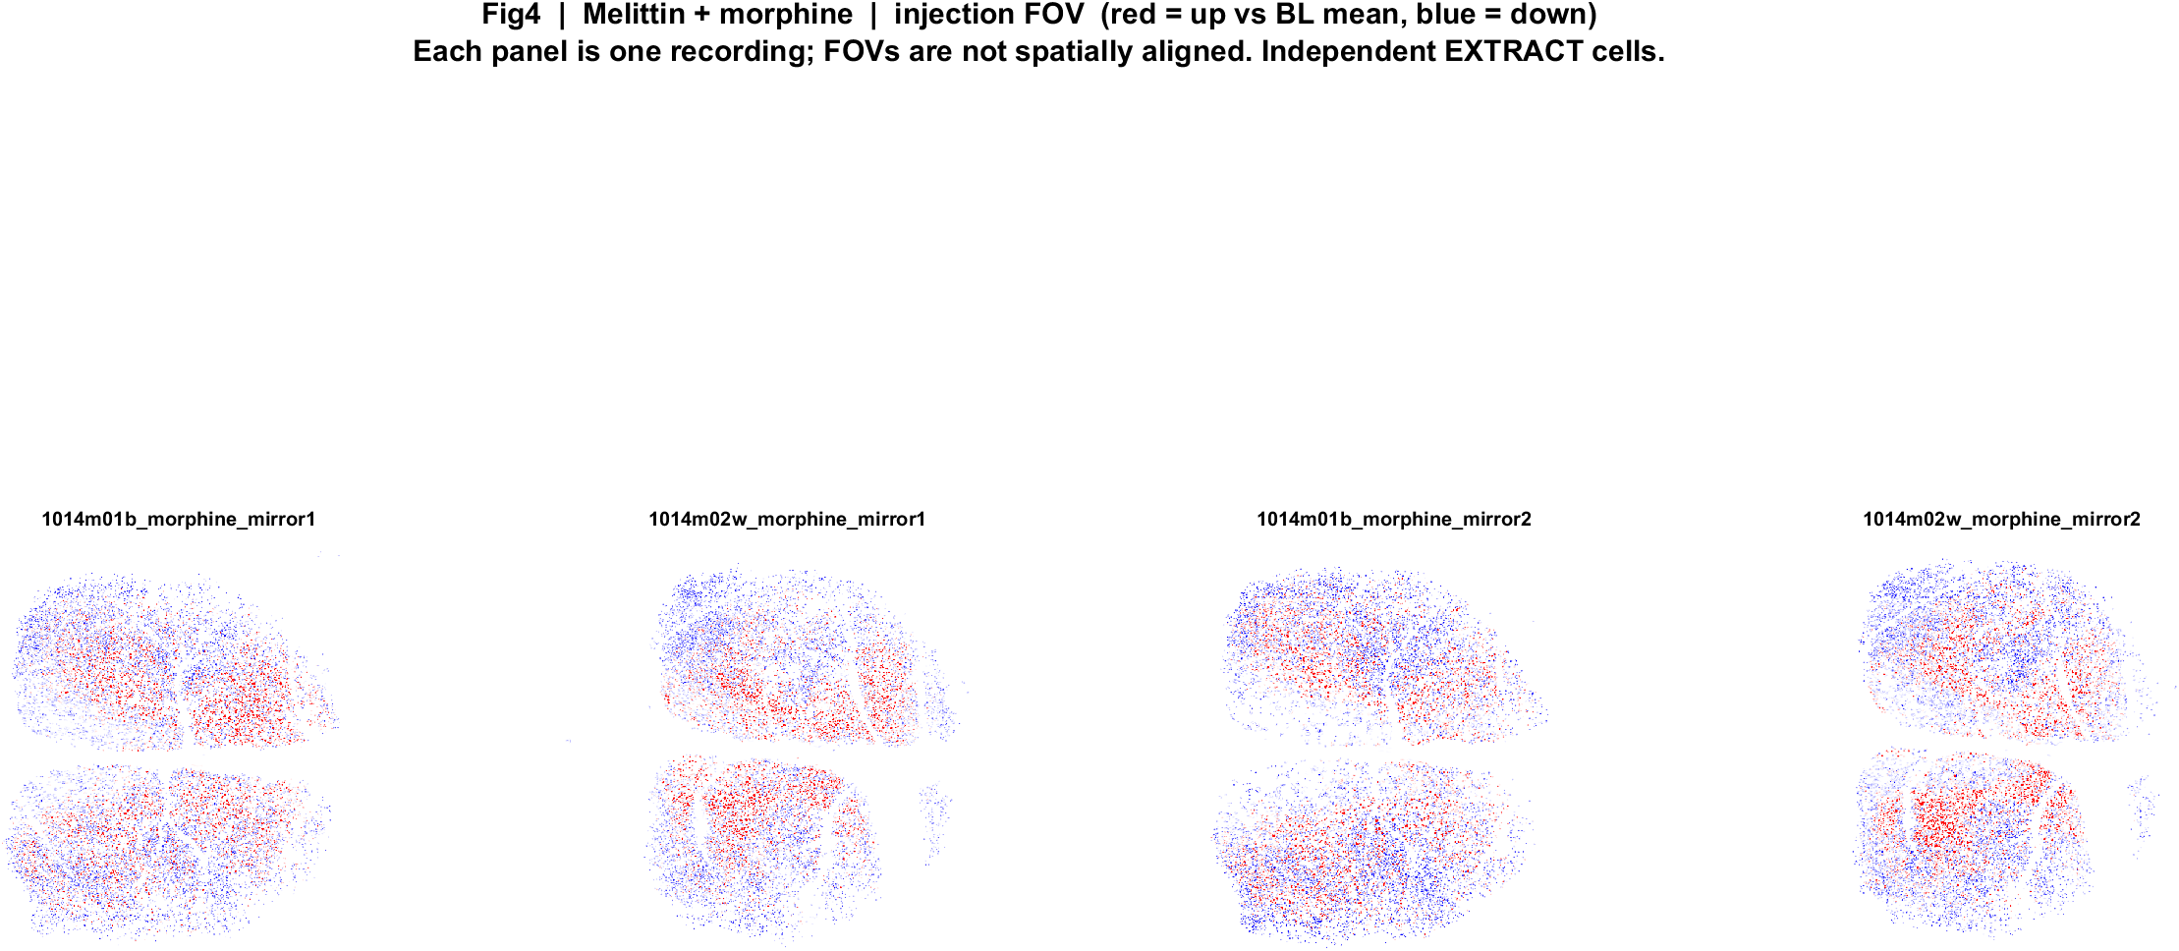
Melittin | FOV maps (same red/blue language)
What: EXTRACT footprints × amp. Red = up vs BL mean, blue = down. P left, A right. Cells are not matched to baseline.
Result: Local mix of up and down, as in face poke. Do not read this as a poke map.

Slide 14
What this does and does not say
• Face poke: every mouse has ~7–13% excited and ~23–30% inhibited poke-locked cells. No Allen/CCF areas yet — only AP on the skull.
• Face poke cannot split pain vs touch vs surprise. There is no drug on those movies.
• Melittin is a different assay. Baseline and injection EXTRACT IDs are independent, so we cannot follow the same cell into morphine.
• Session-level: melittin alone lowers population activity in 7/8 recordings (one CS1014-2w plane goes up after matching durations). Morphine pairing: 3/4 mouse×mirror lines less suppressed or reversed. Small n.
• Please confirm which paradigm to take forward for SBI (face poke vs melittin). Imaging is paused until then.

Slide 15
Allen CCF registered, to see spatial diversity

Slide 16
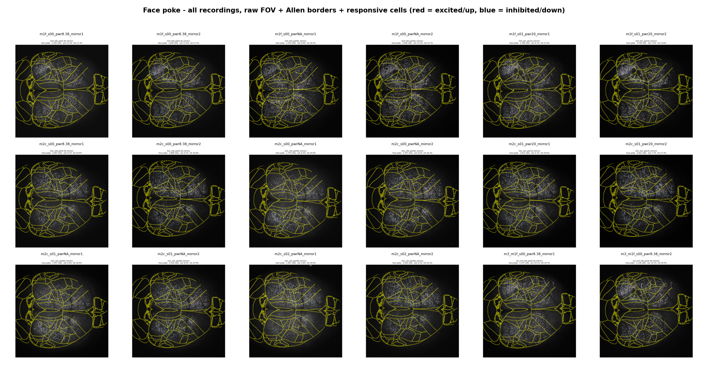

Slide 17
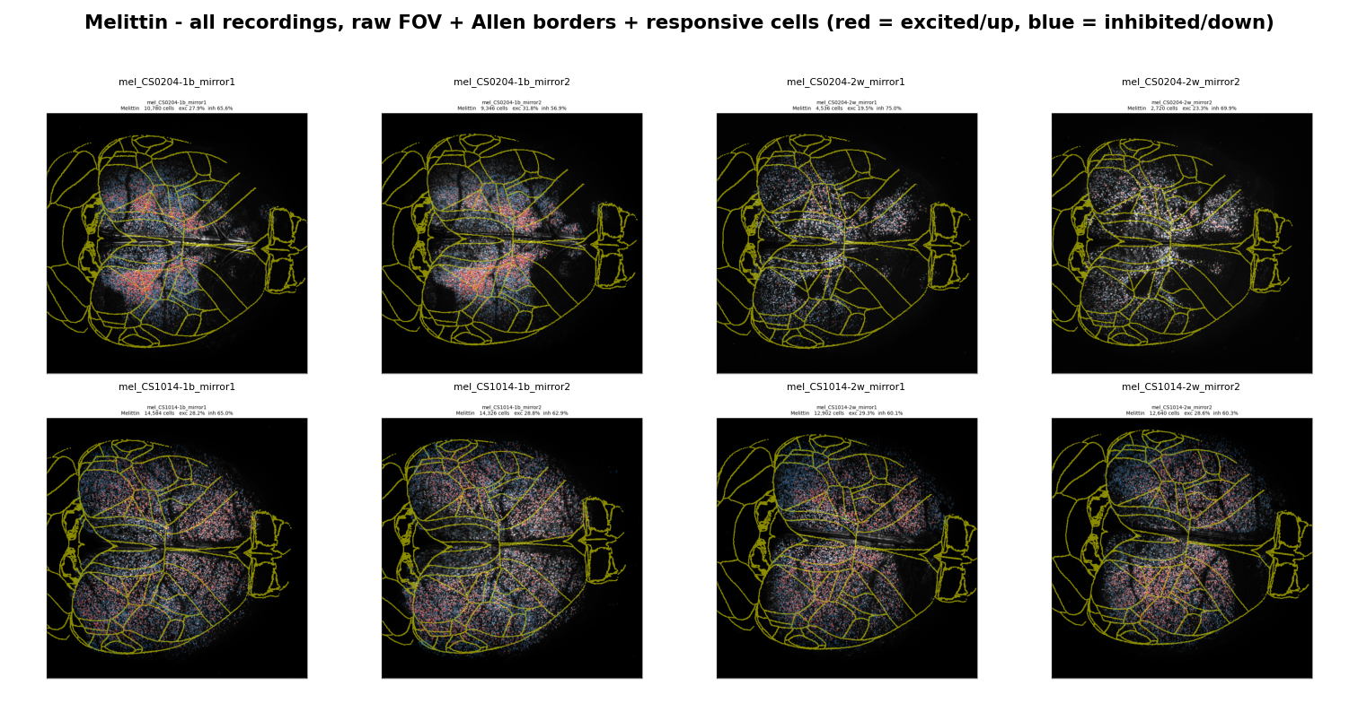

Slide 18
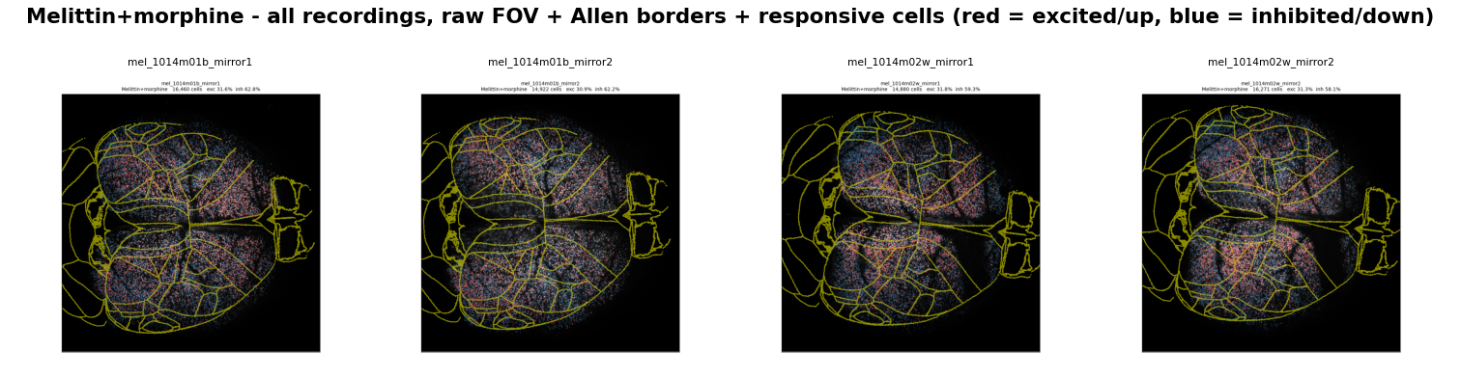

Slide 19
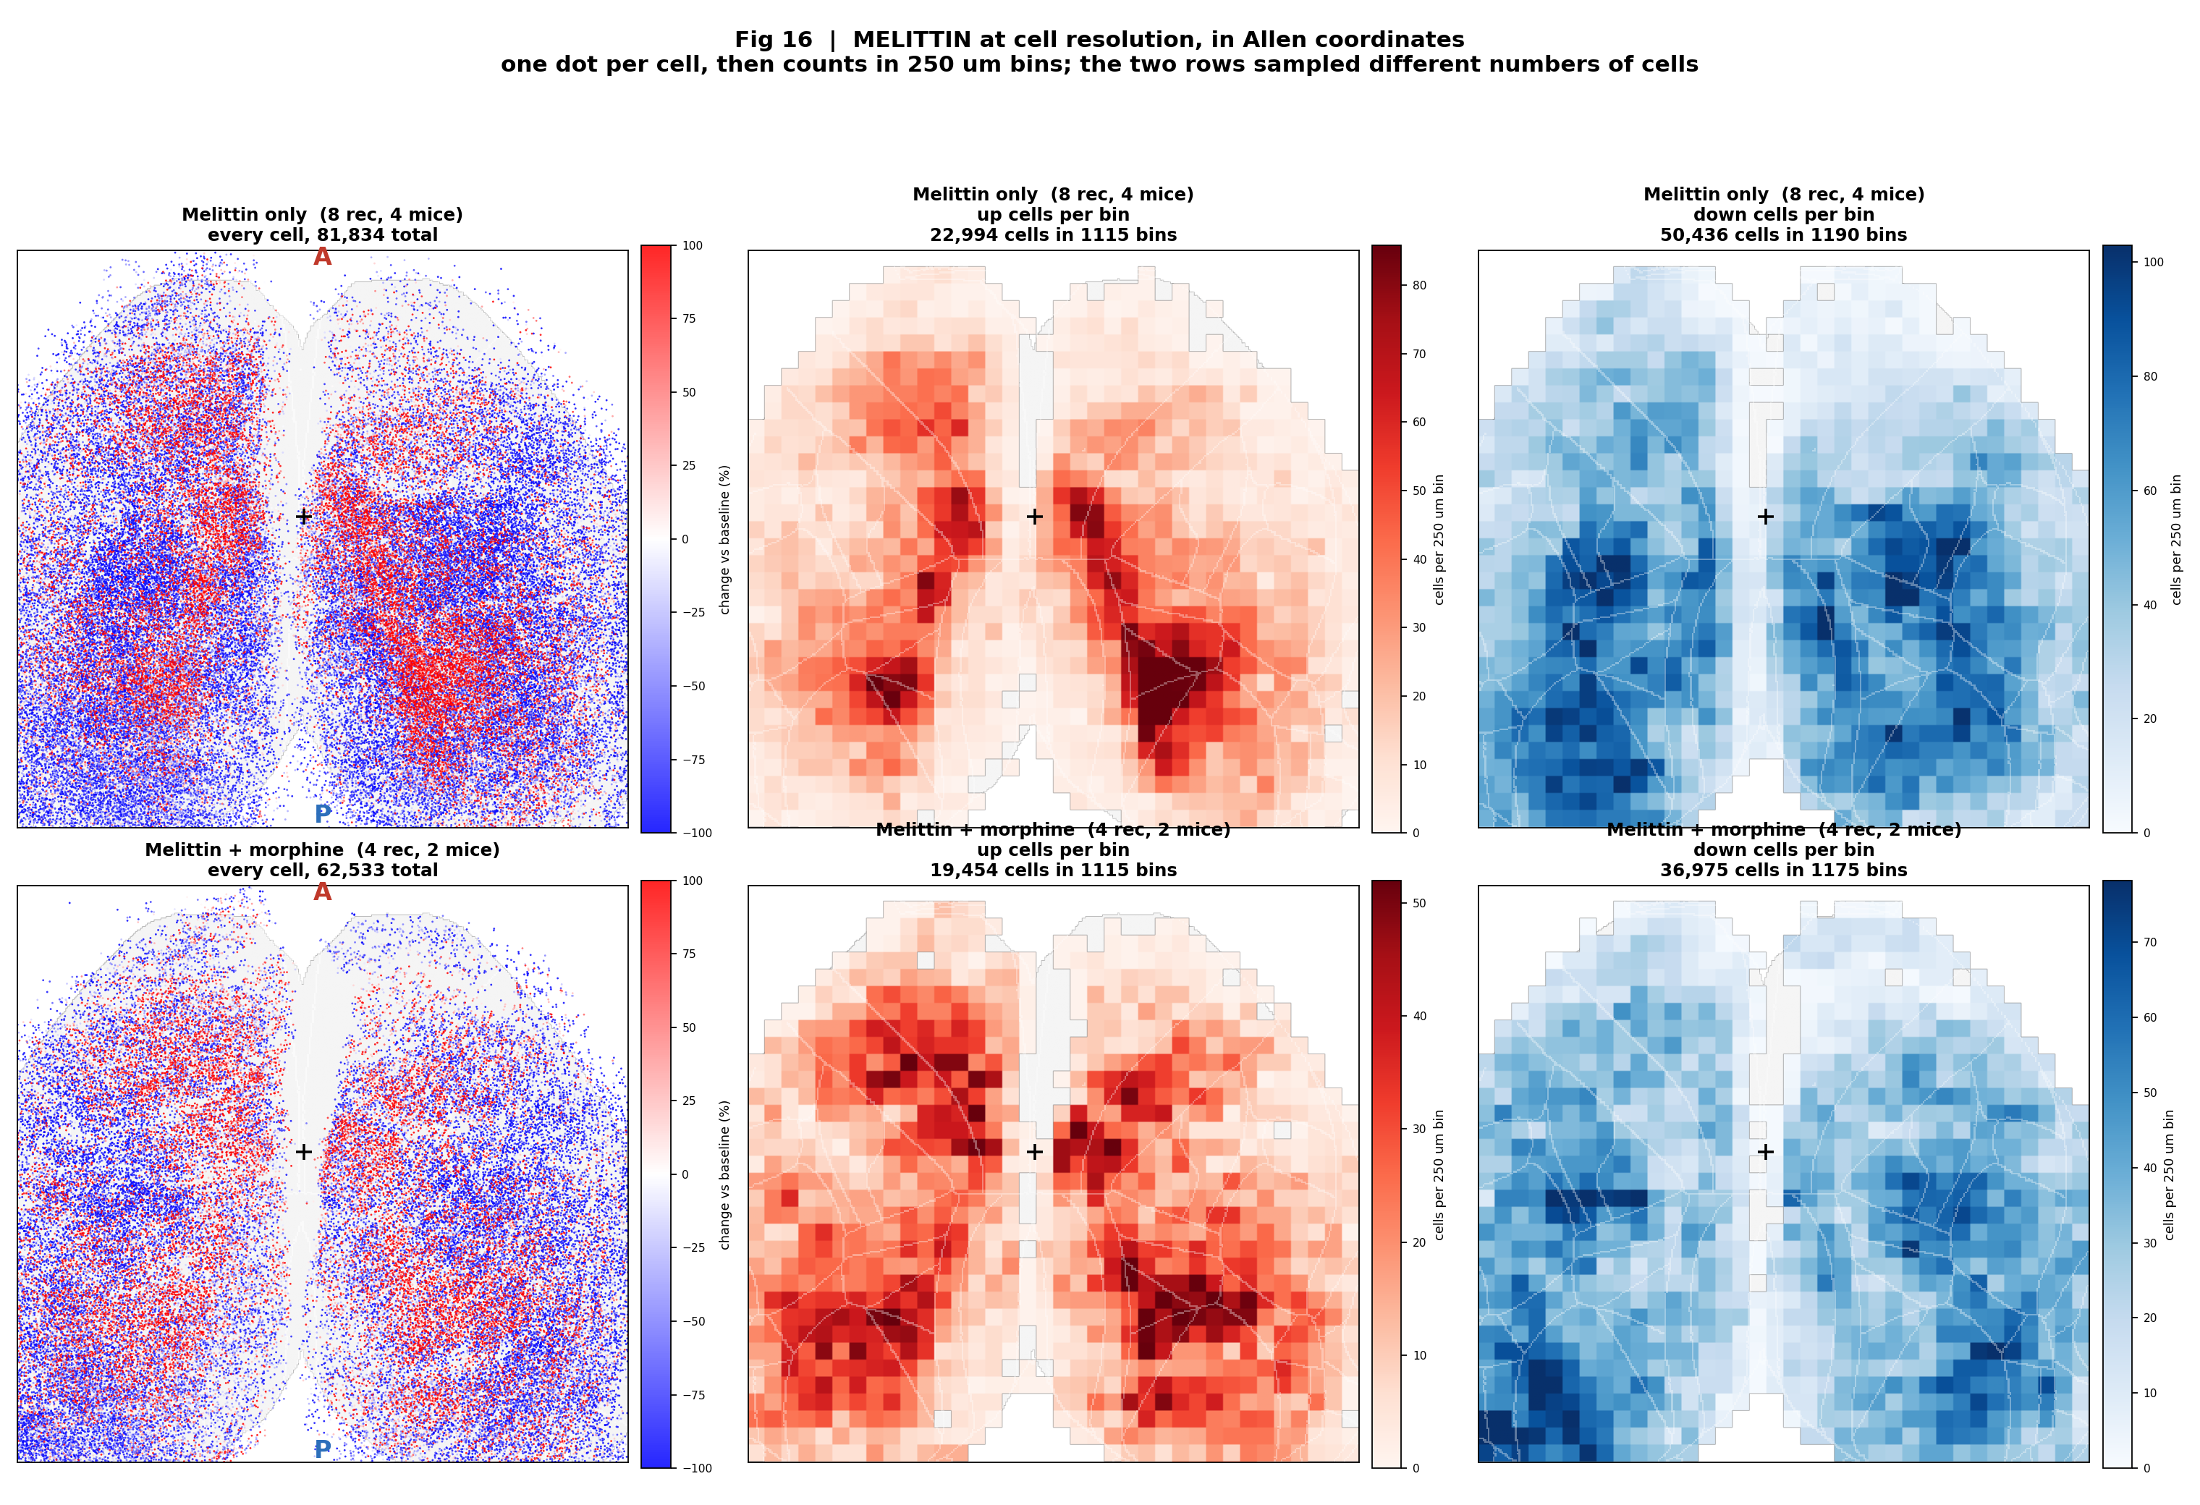
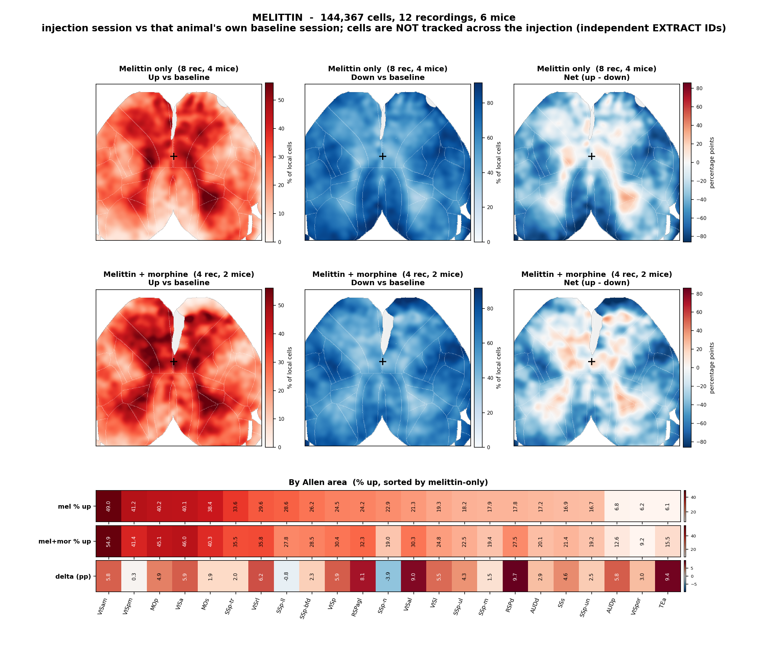
Allen CCF | all recordings merged: Melittin vs Melittin+ morphine
What: Local % of injection cells up (red) or down (blue) vs that day's baseline, on Allen CCF.
Result: Morphine shifts the melittin response toward less suppression - net population change -8.5% to -0.3%, consistent in direction across every measure. Not significant at the animal level (n = 4 vs 2 mice).

Slide 20
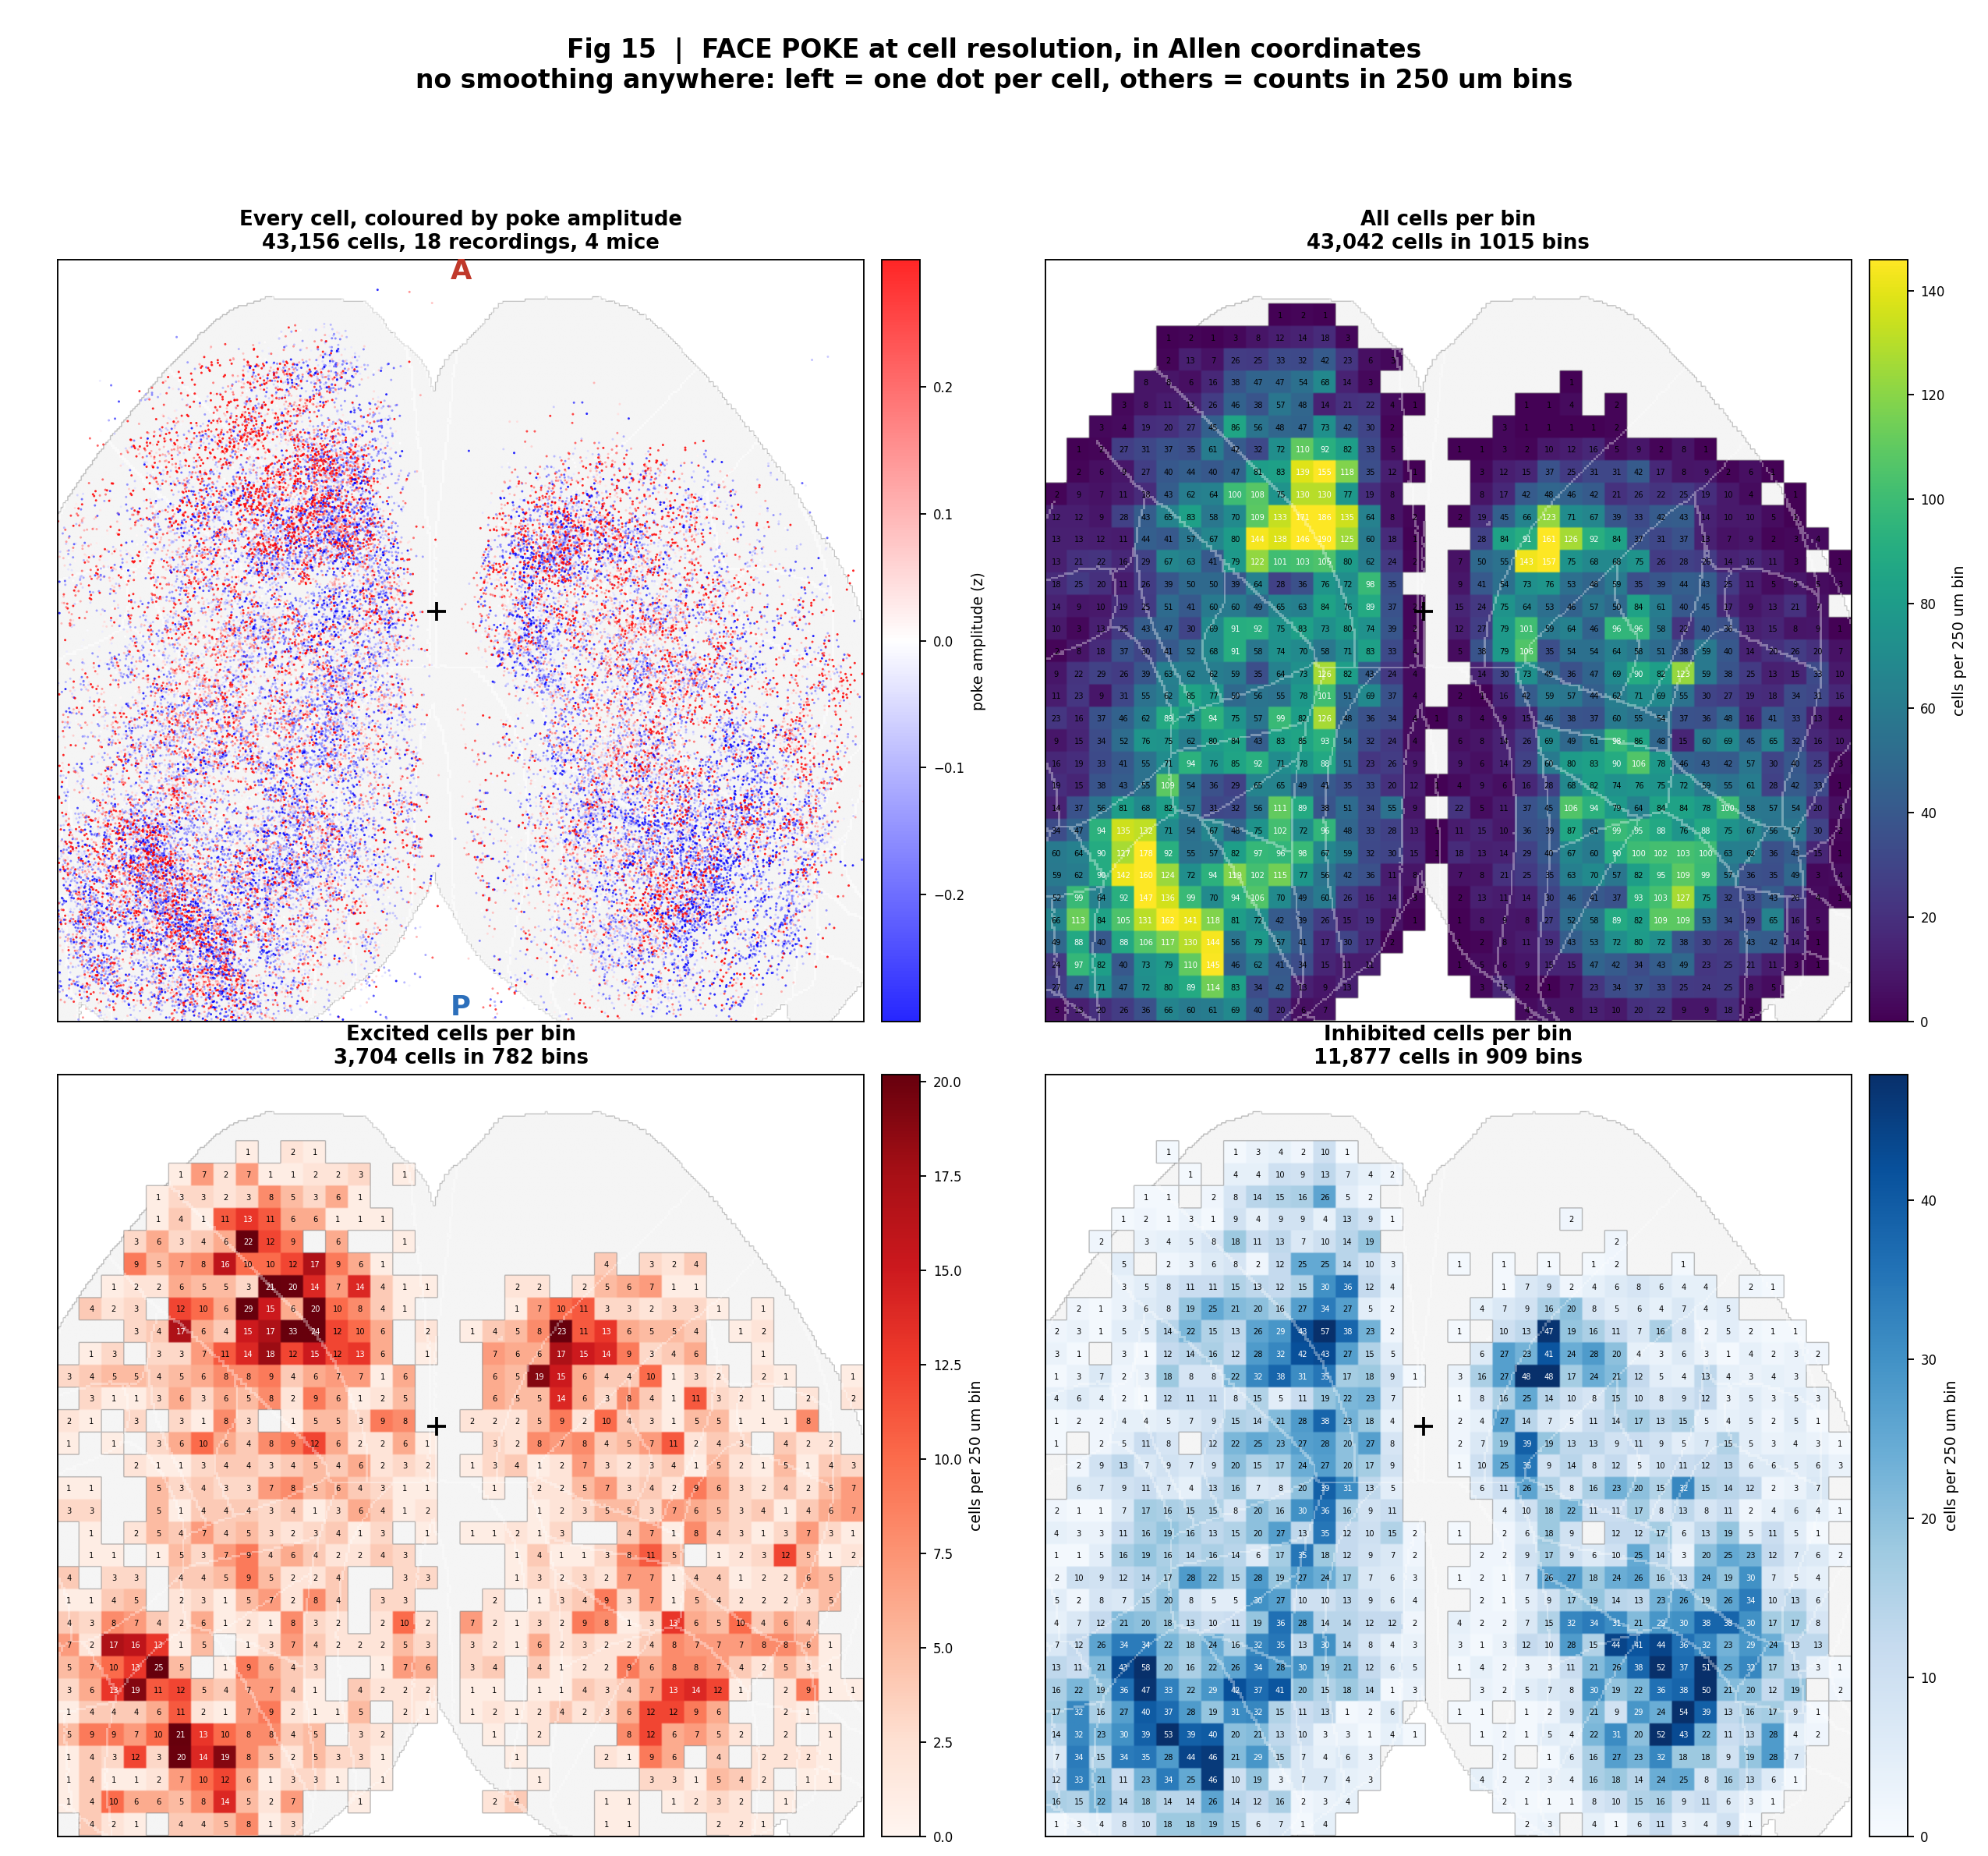
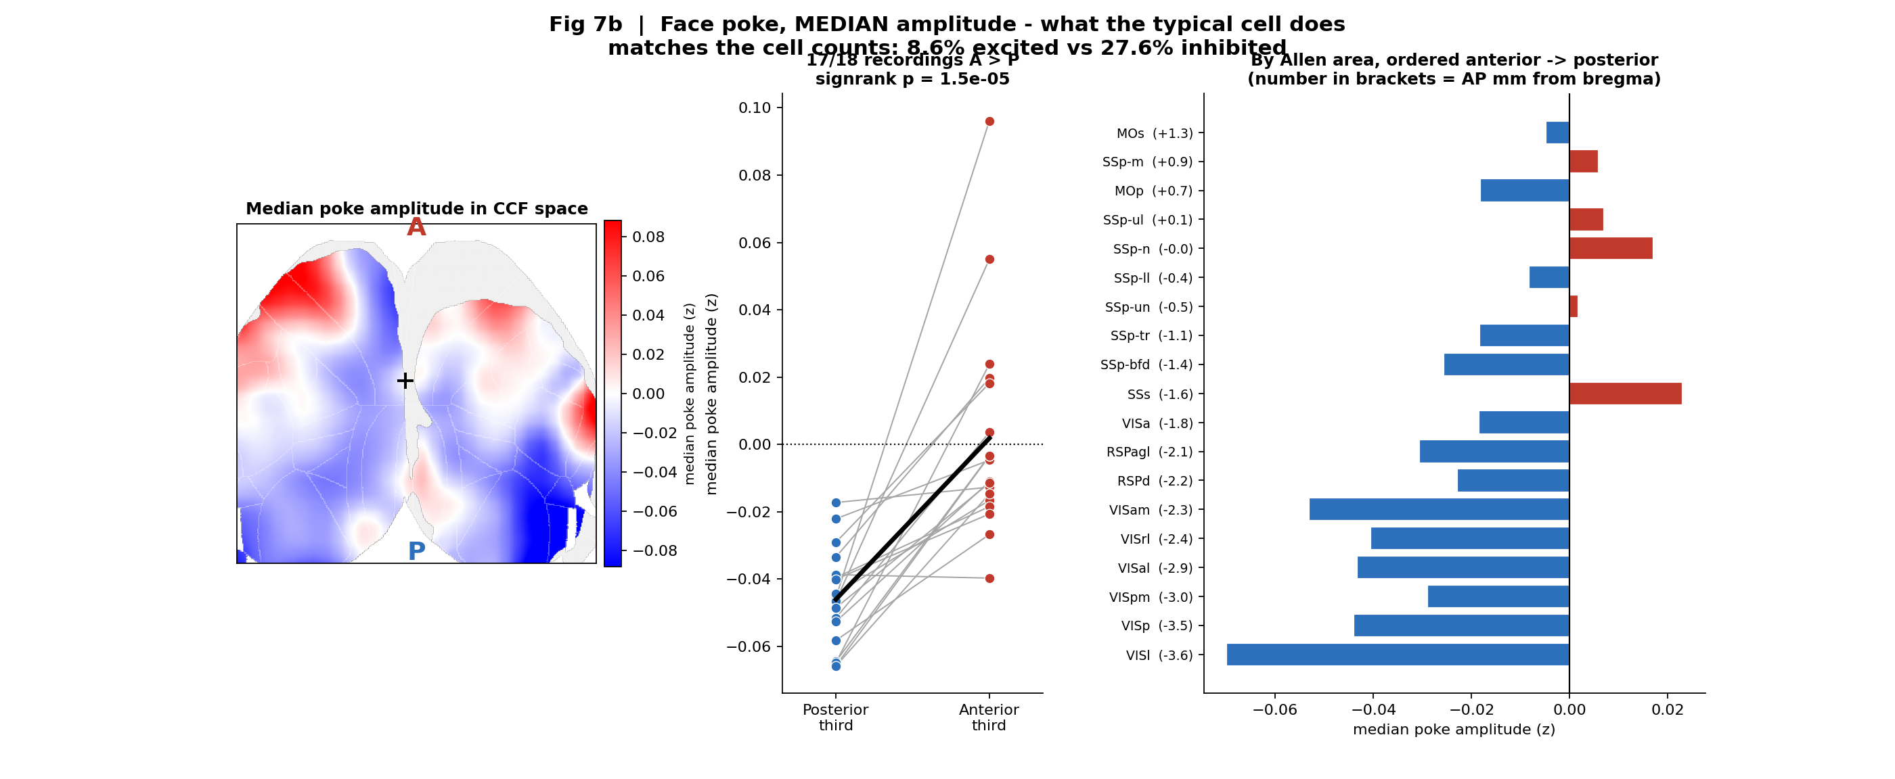
Allen CCF | all recordings merged: face poking
What: Local % of poke-excited (red) and poke-inhibited (blue) cells on Allen CCF. Same cells, peri-poke vs pre-poke.
Result: Poke responses are sparse and inhibition-dominated (8.6% excited vs 27.6% inhibited, 43,156 cells). Excitation is biased anterior and somatosensory (SSs, SSp-n, MOp, MOs); inhibition is richer in visual cortex.

Slide 21
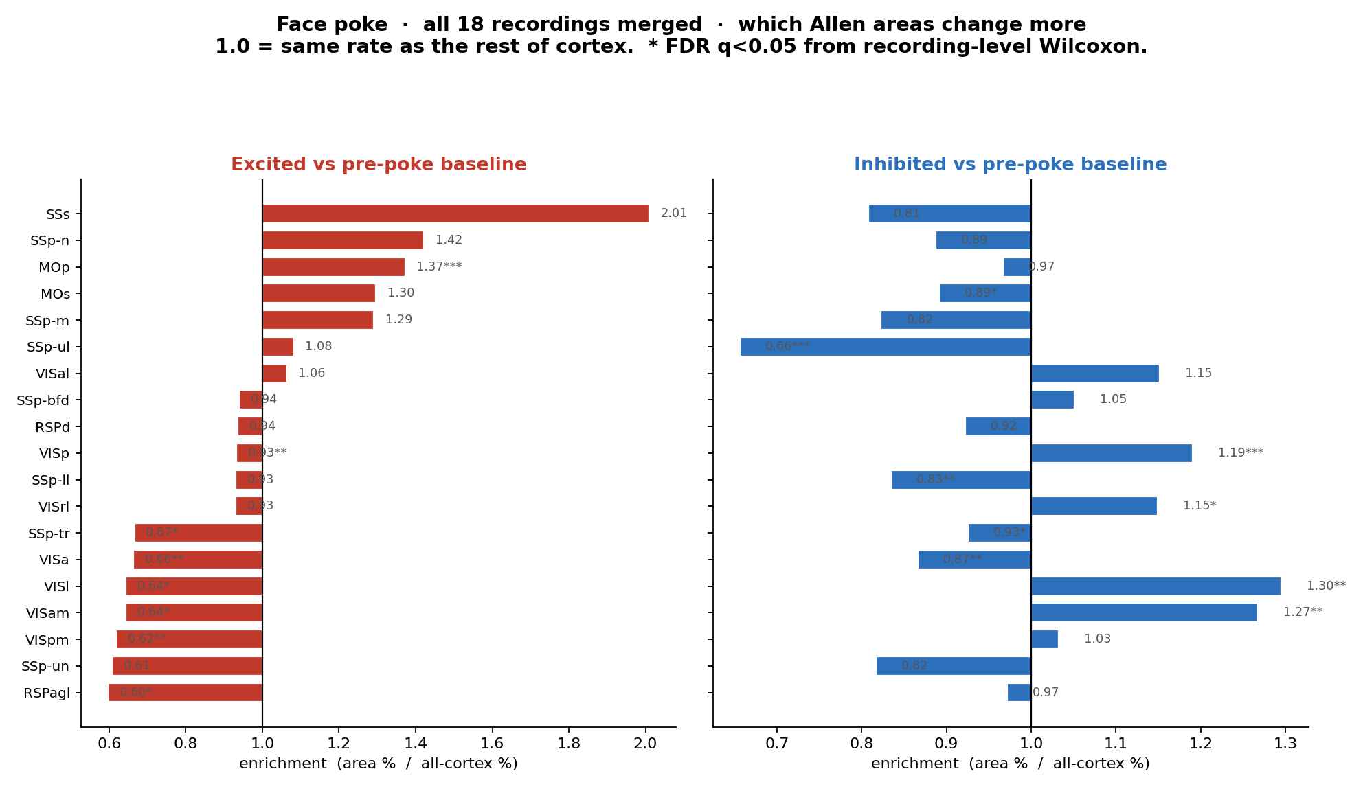
Face poke | region enrichment vs rest of cortex
What: Enrichment = (area %) / (all-cortex %). Stars = FDR q<0.05 from recording-level Wilcoxon.
Result: MOp is significantly over-excited (1.37x); inhibition is enriched in VISl, VISam, VISp and VISrl.

Slide 22
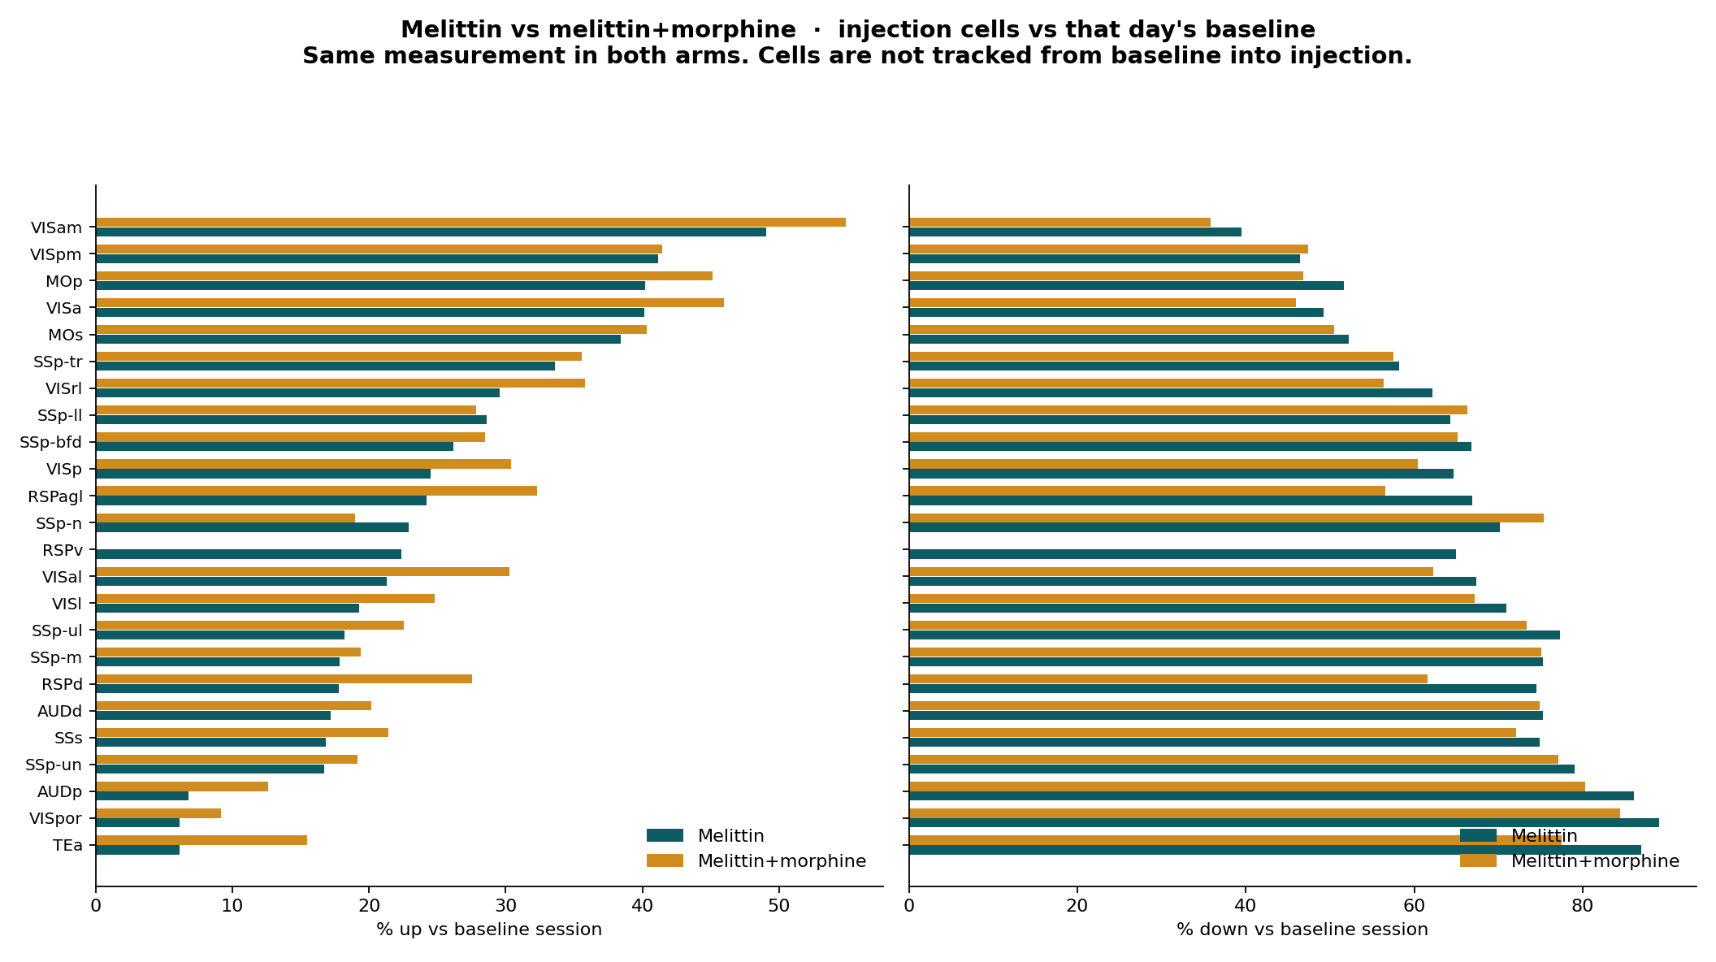
Melittin vs melittin+morphine | % up/down by area
What: % of injection cells up or down vs that day's baseline, by Allen area.
Result: Melittin up is highest in VISam / MOp / VISa / MOs; morphine raises % up in almost every area but the rank order is unchanged.

Slide 23
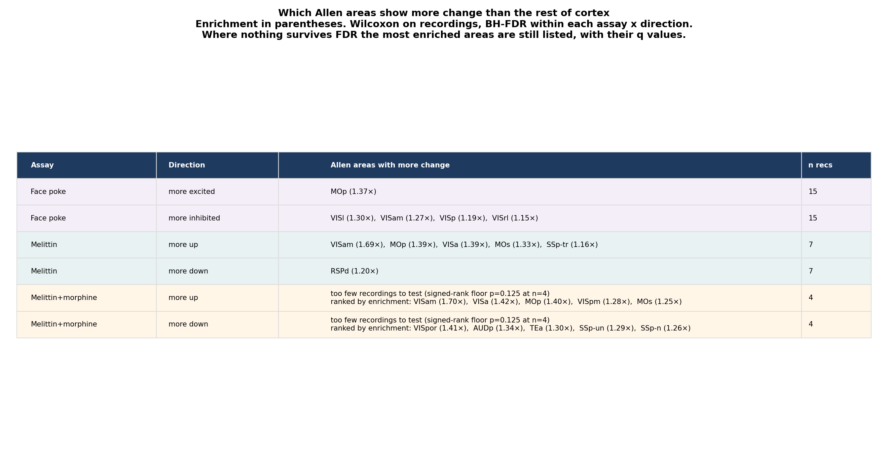
Which areas change more (FDR, recording-level)
What: Recording-level Wilcoxon of (area rate minus that recording's overall rate), BH-FDR within each assay x direction.
Result: Face-poke excitation: MOp. Face-poke inhibition: VISl, VISam, VISp, VISrl. Melittin up: VISam, MOp, VISa, MOs, SSp-tr. Melittin+morphine cannot be tested at 4 recordings, so its areas are ranked by enrichment instead.

Slide 24
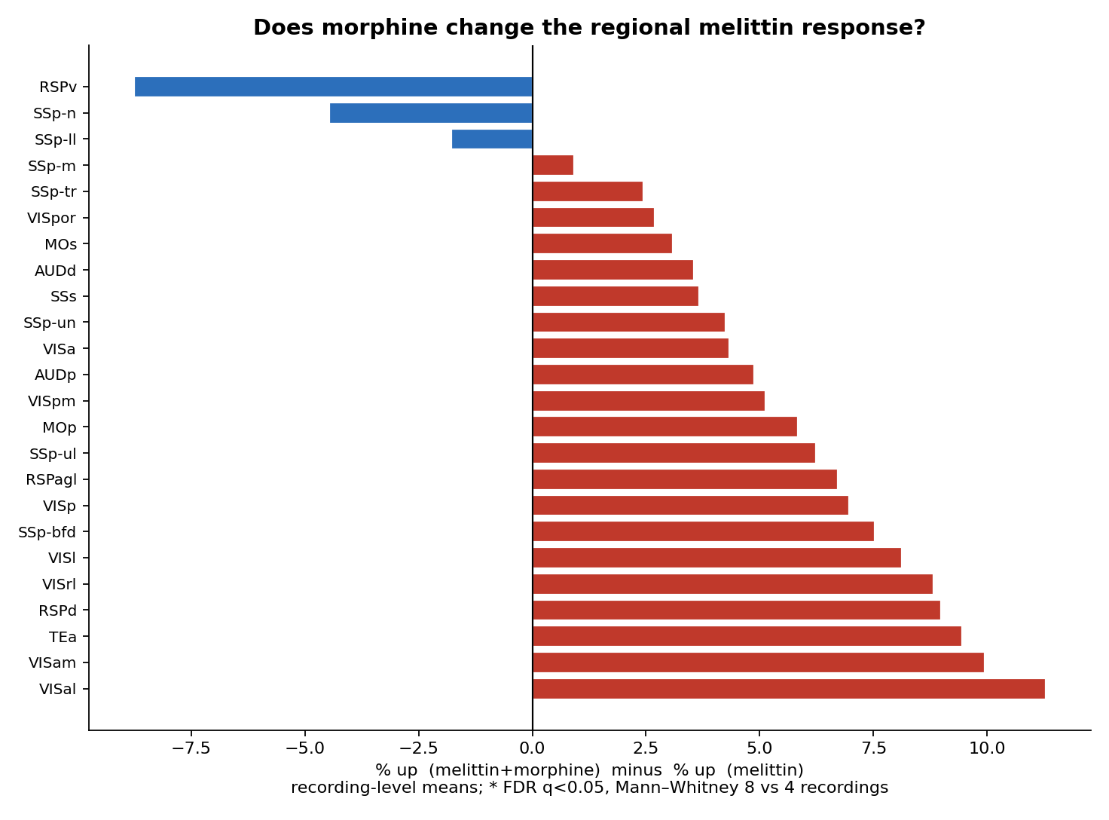
Morphine minus melittin | by Allen area
What: Recording-level % up (melittin+morphine) minus % up (melittin), by Allen area.
Result: Morphine raises % up in almost every area (+3 to +11 points), most in VISam, VISa, RSPd. With 4 recordings the recording-level test cannot be run at all - the signed-rank floor is p = 0.125 at n = 4 - so this is ranked by effect size, not tested.

Slide 25
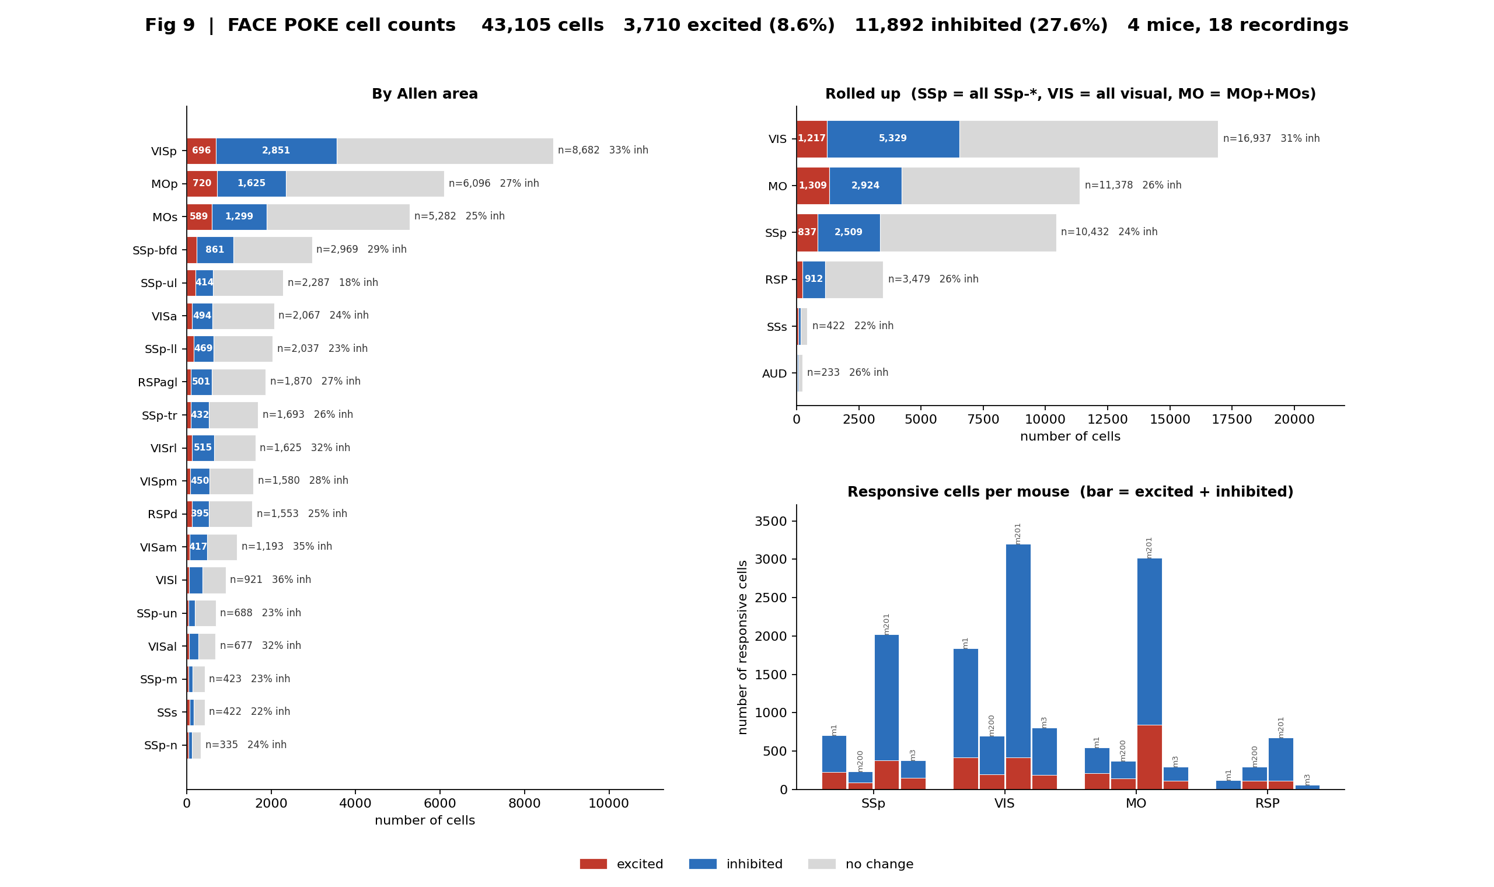
Face poke | exact cell counts per Allen area
What: Bar length is the number of cells, so it reflects how much of each area the FOV sampled. The % alongside is the fair between-area comparison.
Result: SSp: 2,509 inhibited vs 837 excited of 10,432 cells. VIS: 5,329 vs 1,217 of 16,937. MO: 2,924 vs 1,309 of 11,378. Every area is inhibition-dominated in every mouse.

